Slide 1
New Workbook
File created on: 5/8/2024 12:08:47 PM

Slide 2
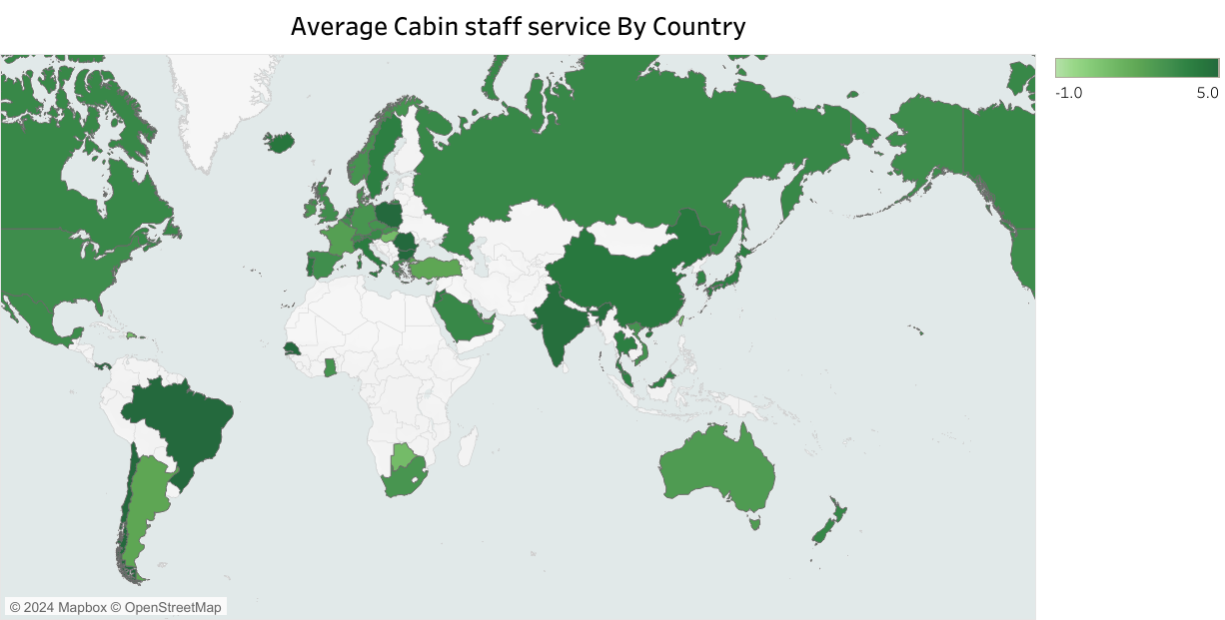

Slide 3
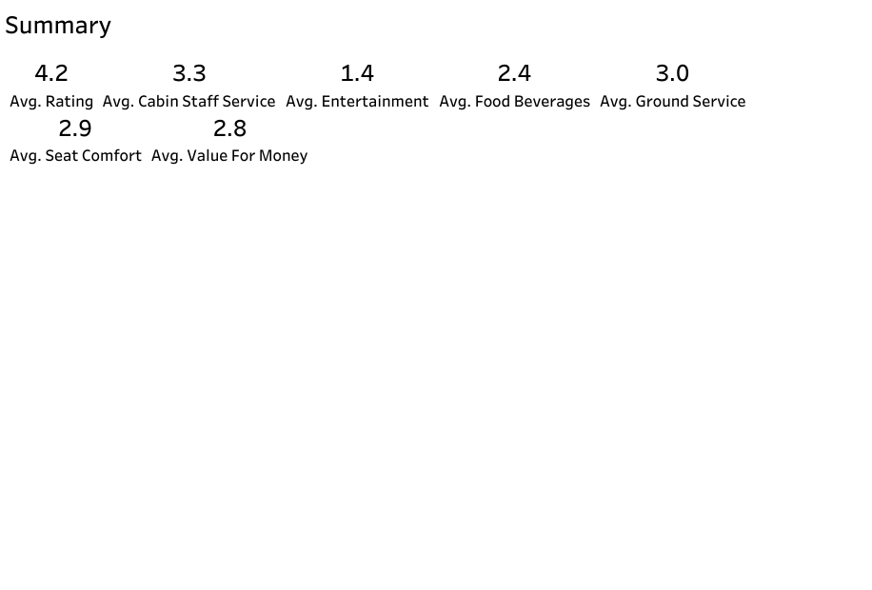

Slide 4
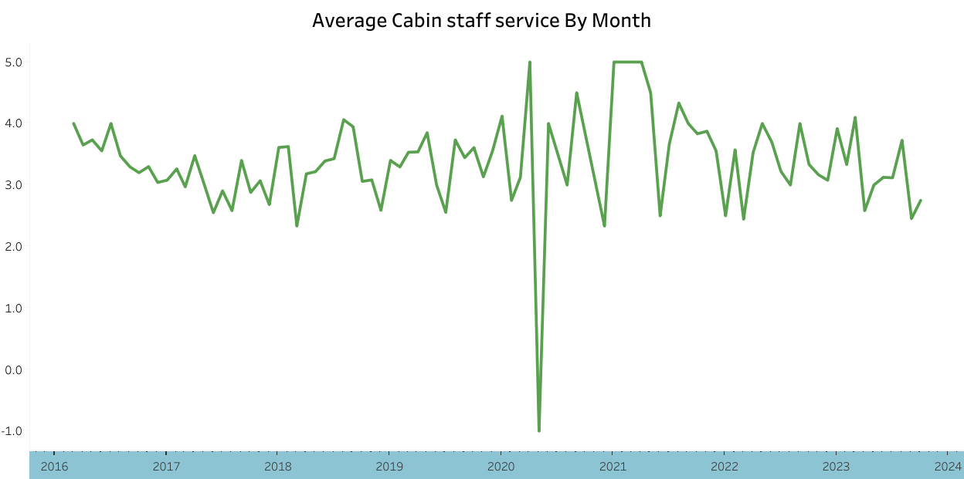

Slide 5


Slide 6
